Slide 1
August 2023 release of Power BI apps on telemetry
Dynamics 365 Business Central

Slide 2
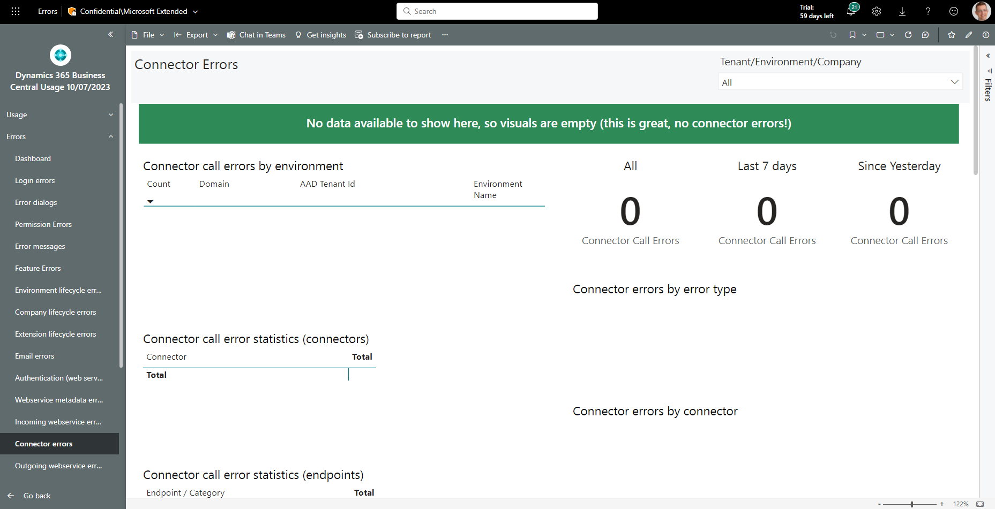
On all error pages: green banner shown if no data
If no data is present on an error page, we now show a green banner

Slide 3
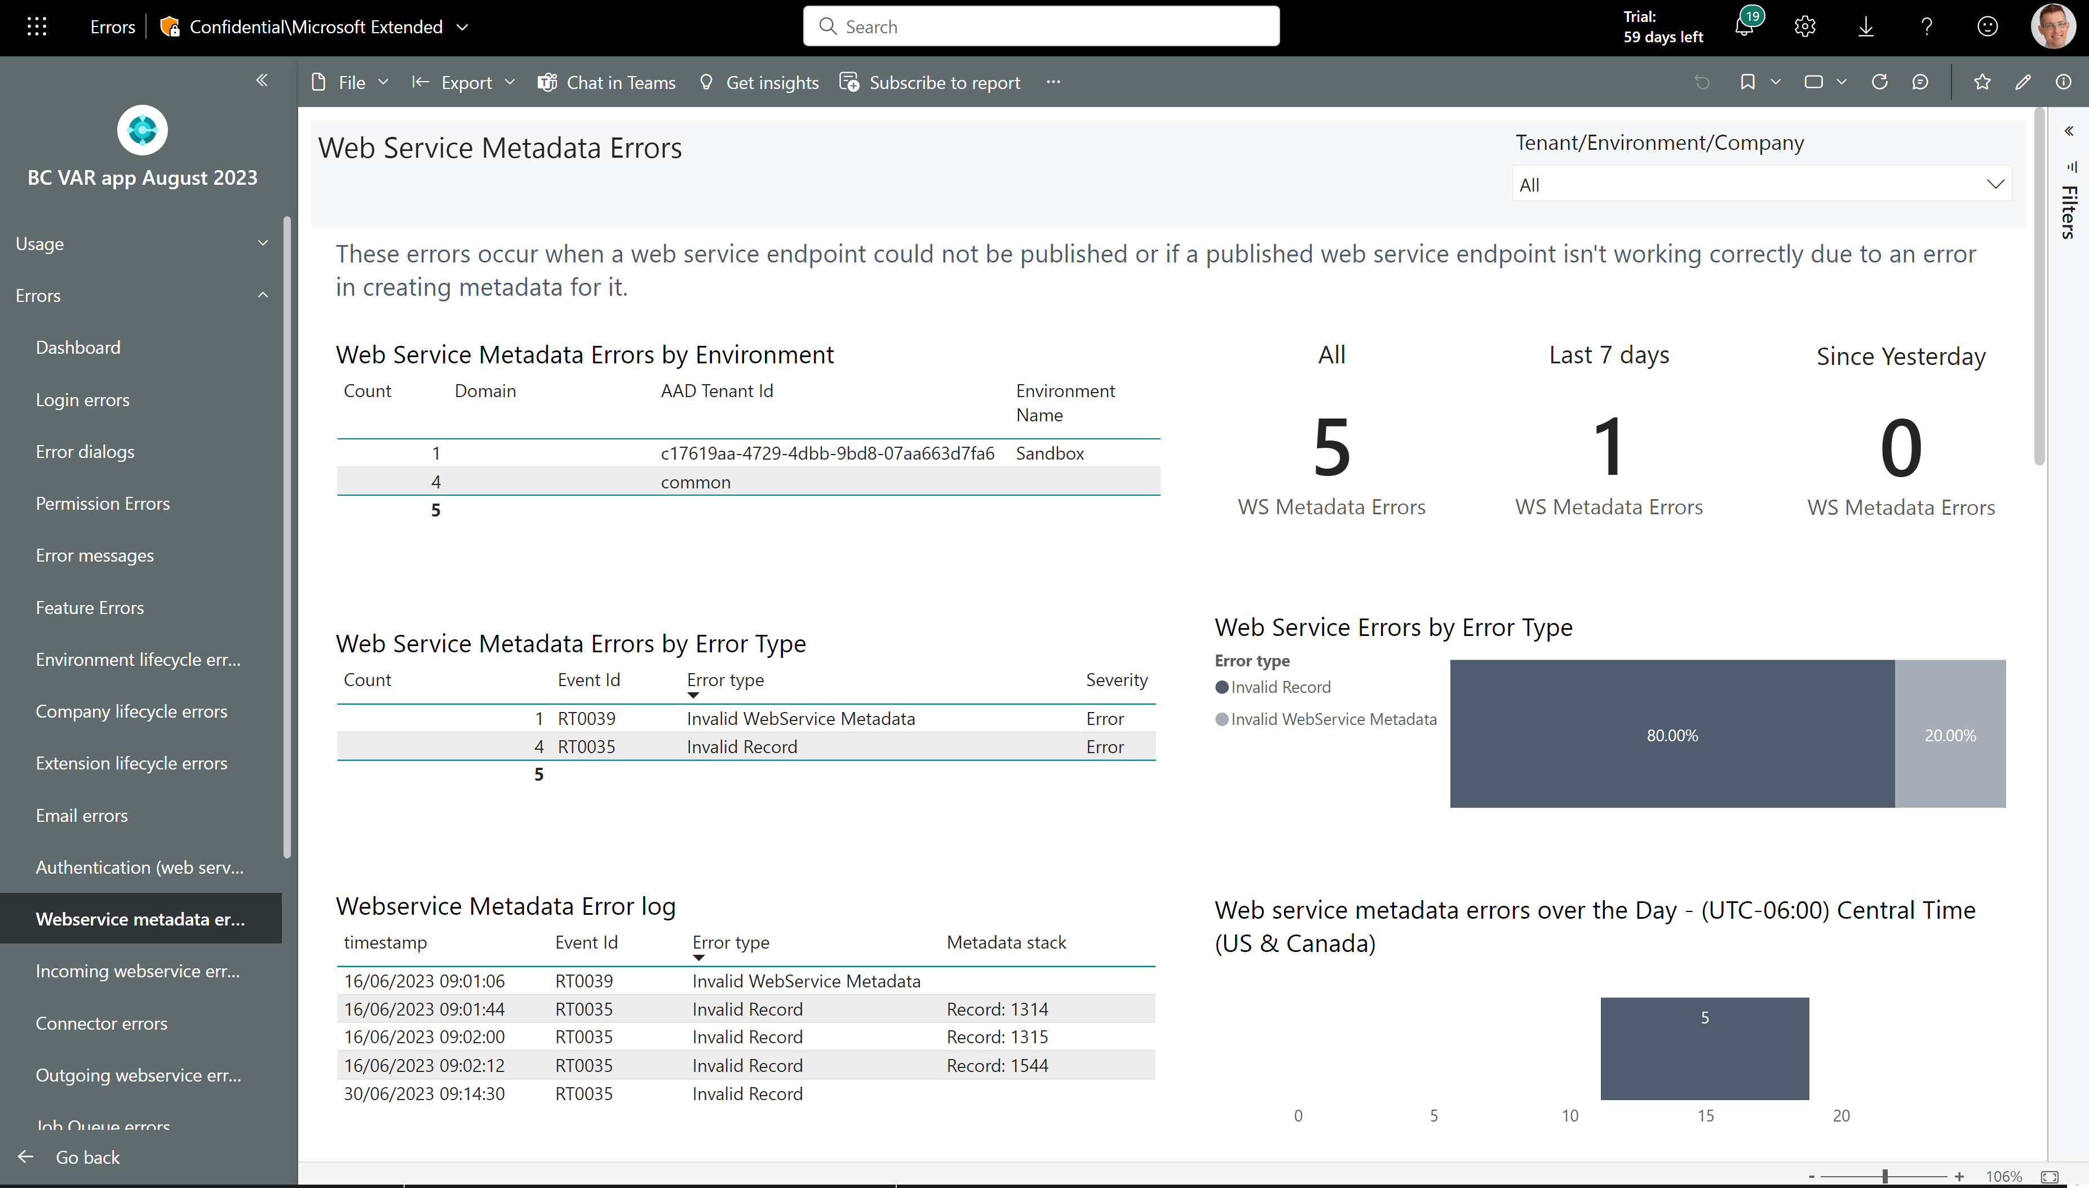
New page: Web service metadata errors
Find web service endpoints that fail at runtime and how to fix them

Slide 4
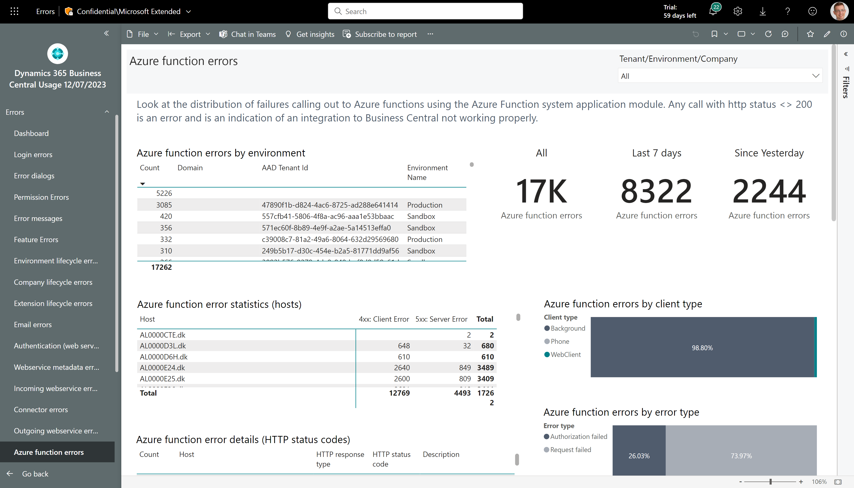
New page: Azure function errors
Find errors happening in integrations to Azure functions

Slide 5
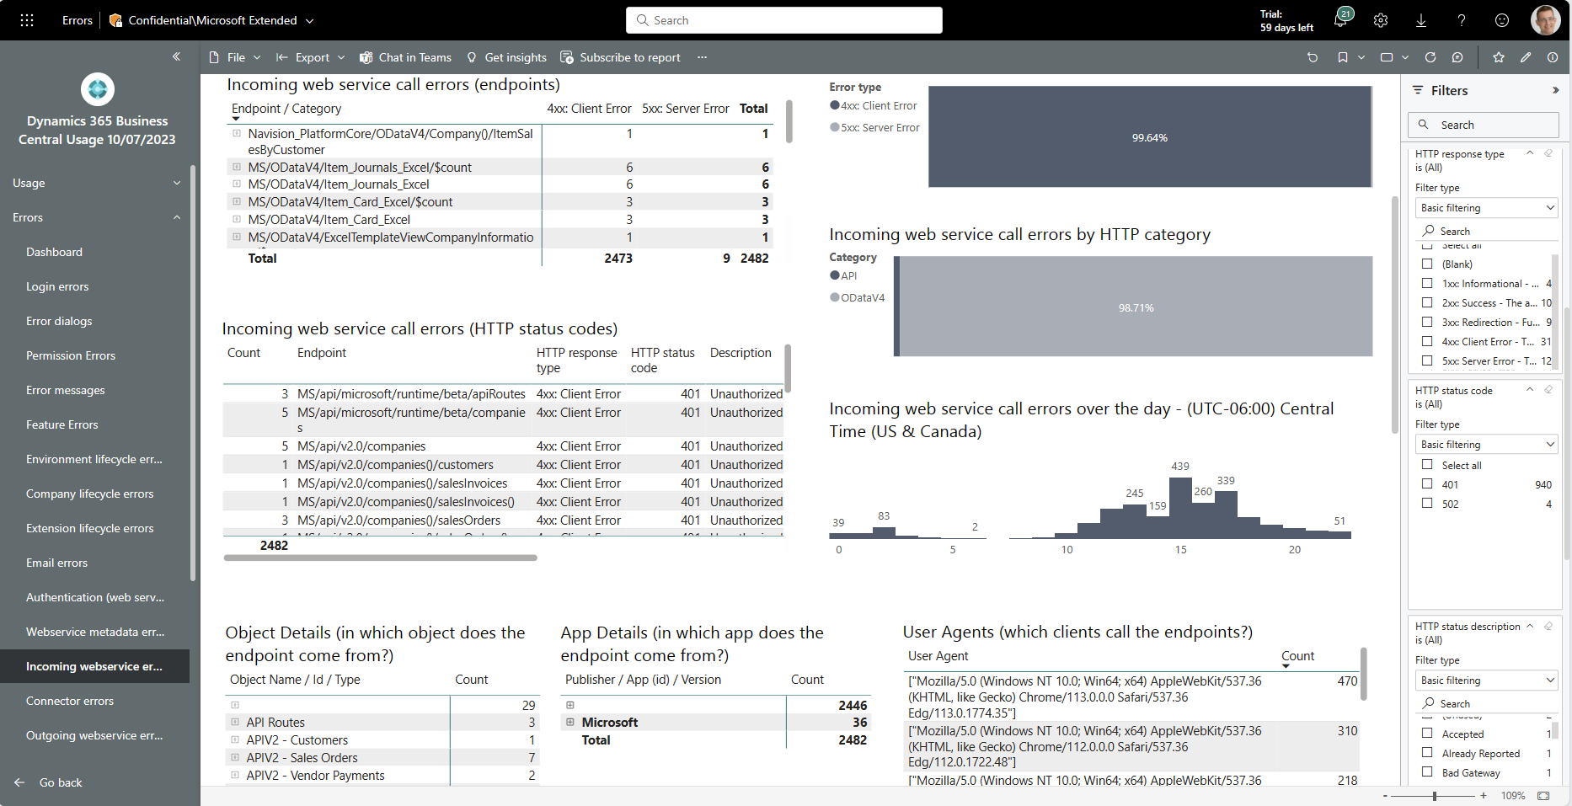
Easier troubleshooting of incoming web service errors
Improved filters on HTTP status codes
Two new visuals that show HTTP status code view on errors

Slide 6
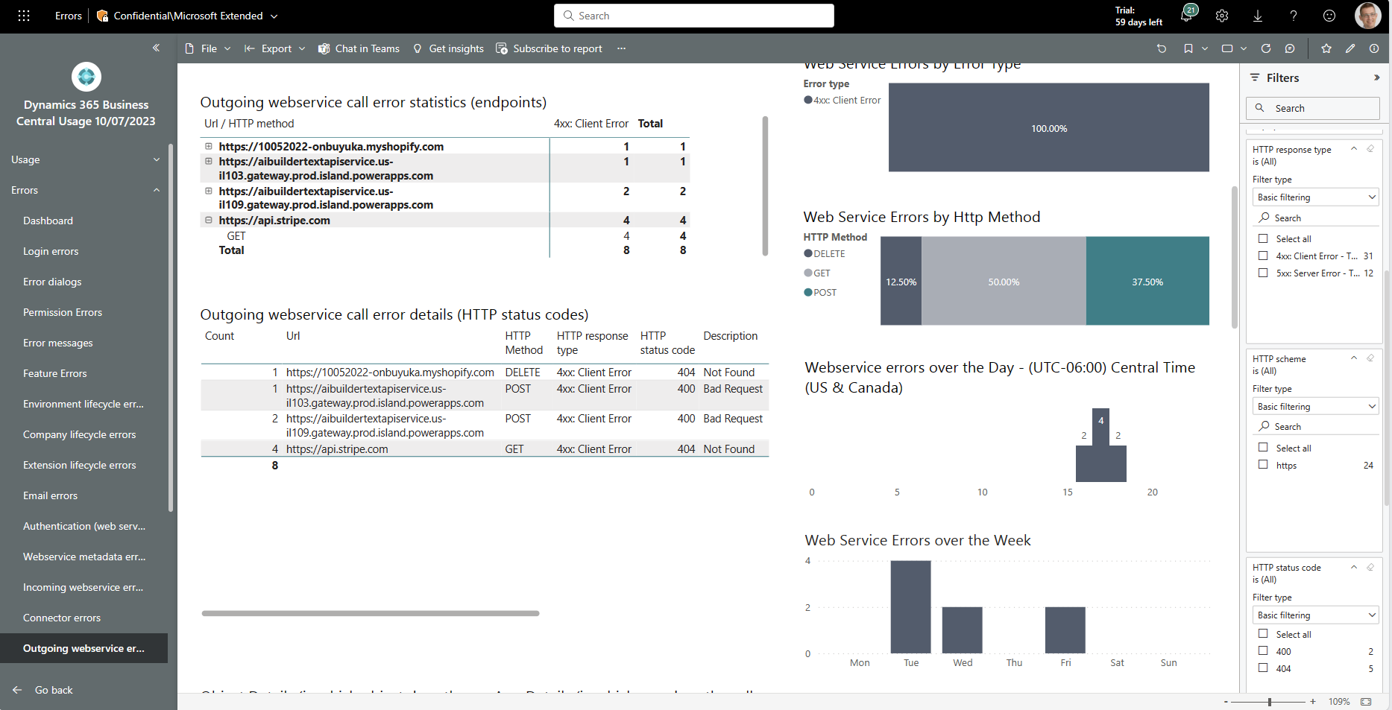
Easier troubleshooting of outgoing web service errors
Improved filters on HTTP status codes
Two new visuals that show HTTP status code view on errors

Slide 7
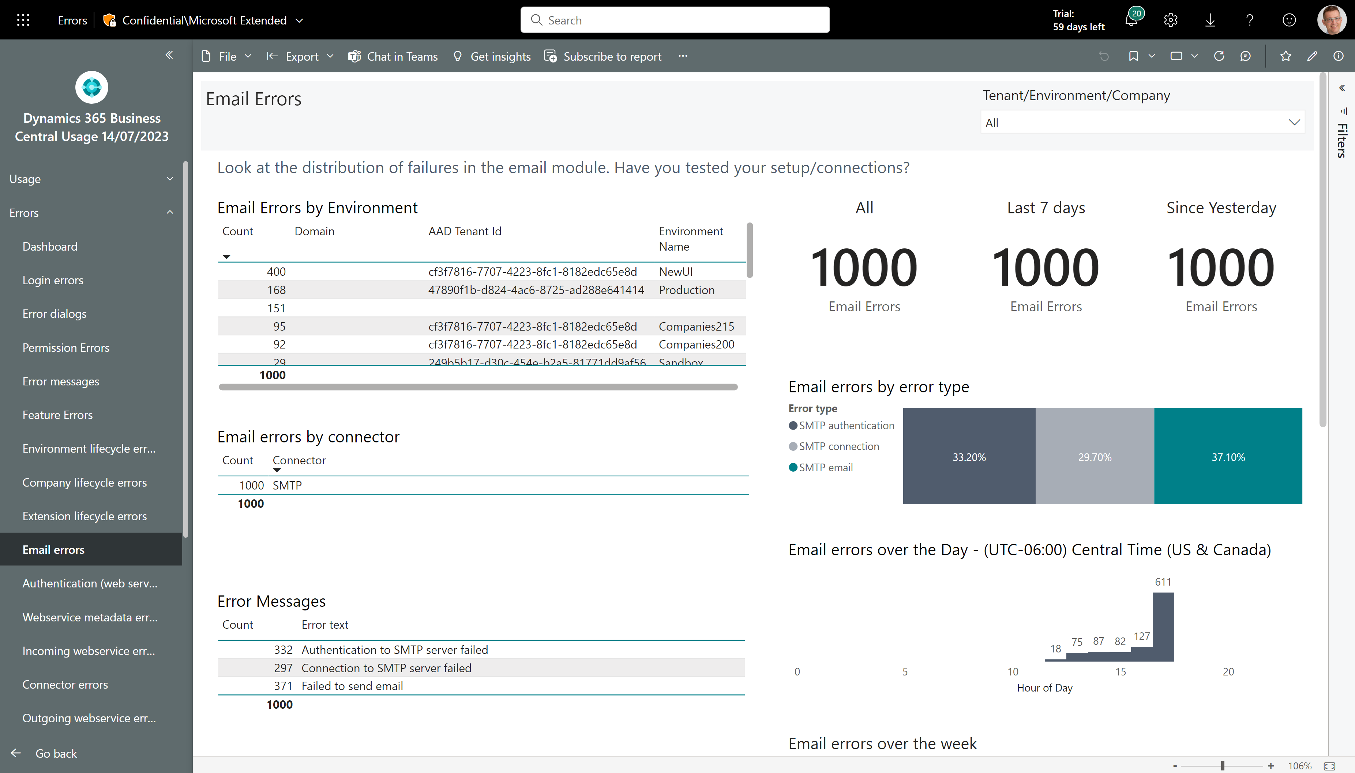
Easier troubleshooting of email errors (using new SMTP error signal from 22.3)
Three new SMTP email error events added in 22.3. Showing them here.

Slide 8
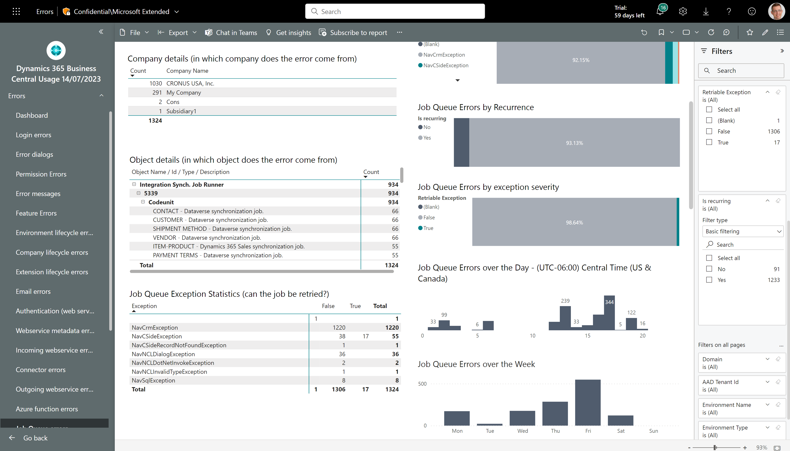
Easier troubleshooting of job queue errors
New visuals showing non-retriable job queue exceptions and recurring failing job queue entries
Improved filters to find problematic job queue entries
New visual showing non-retriable job queue exceptions

Slide 9
Get the apps from Appsource
For environment telemetry https://aka.ms/bctelemetryreport
For app telemetry https://aka.ms/bctelemetry-isv-app

